Slide 1

BREAST CANCER BUDDIES
By CSta Fiesta
An, Gio, Jonathan, Minh

Slide 2
Project Description and Goals
Provide an informative webpage about breast cancer that gives users basic information through:
Stories of real patients and survivors
Tips & Tricks on everyday life
Forum to post messages about anything related to breast cancer
Our achieved goals:
Have helpful information delivered through a visually appealing medium, which does not currently exist.
Have a safe space for people to exchange information with other users in order to accomplish this.

Slide 3
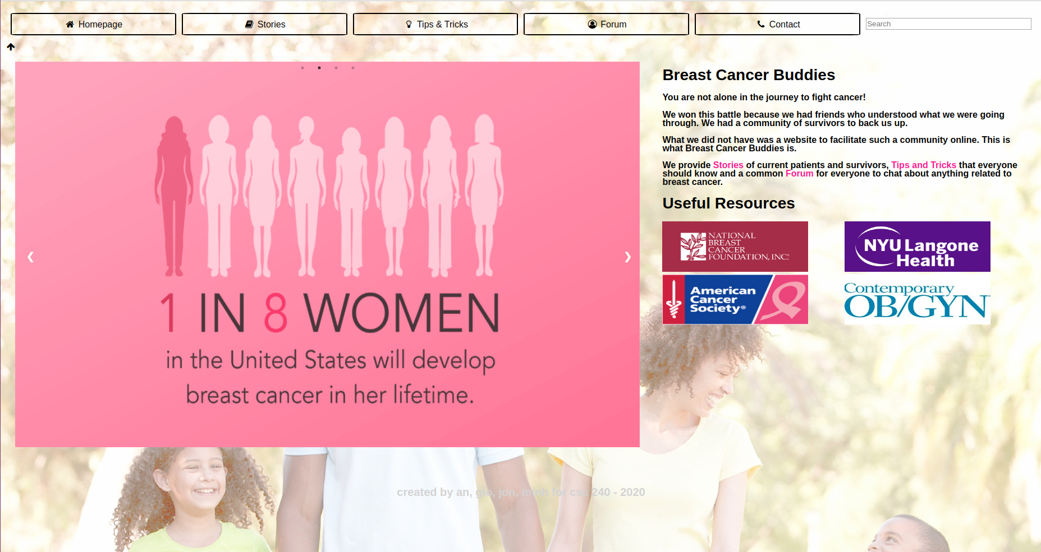
Homepage

Slide 4
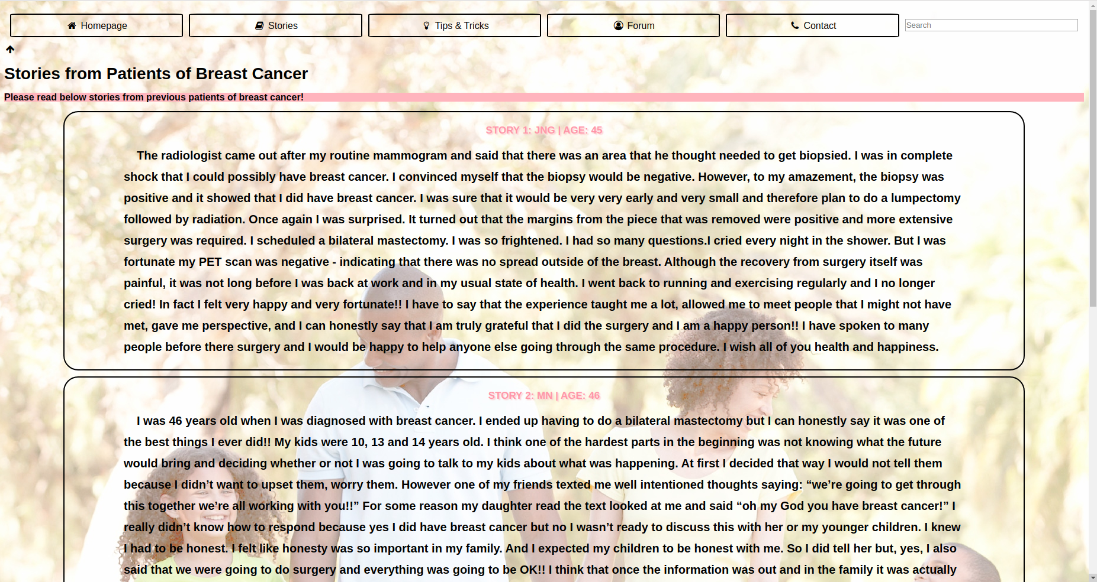
Stories

Slide 5
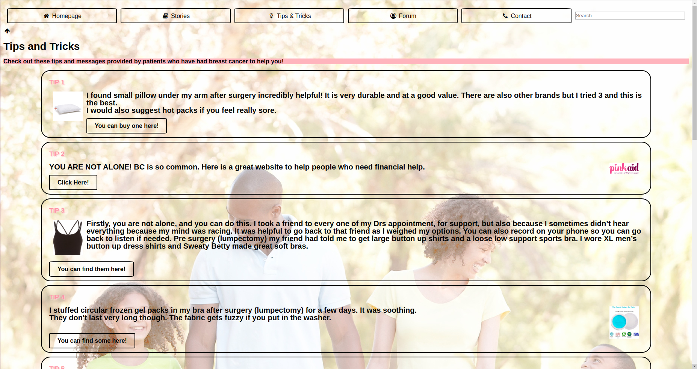
Tips and Tricks

Slide 6
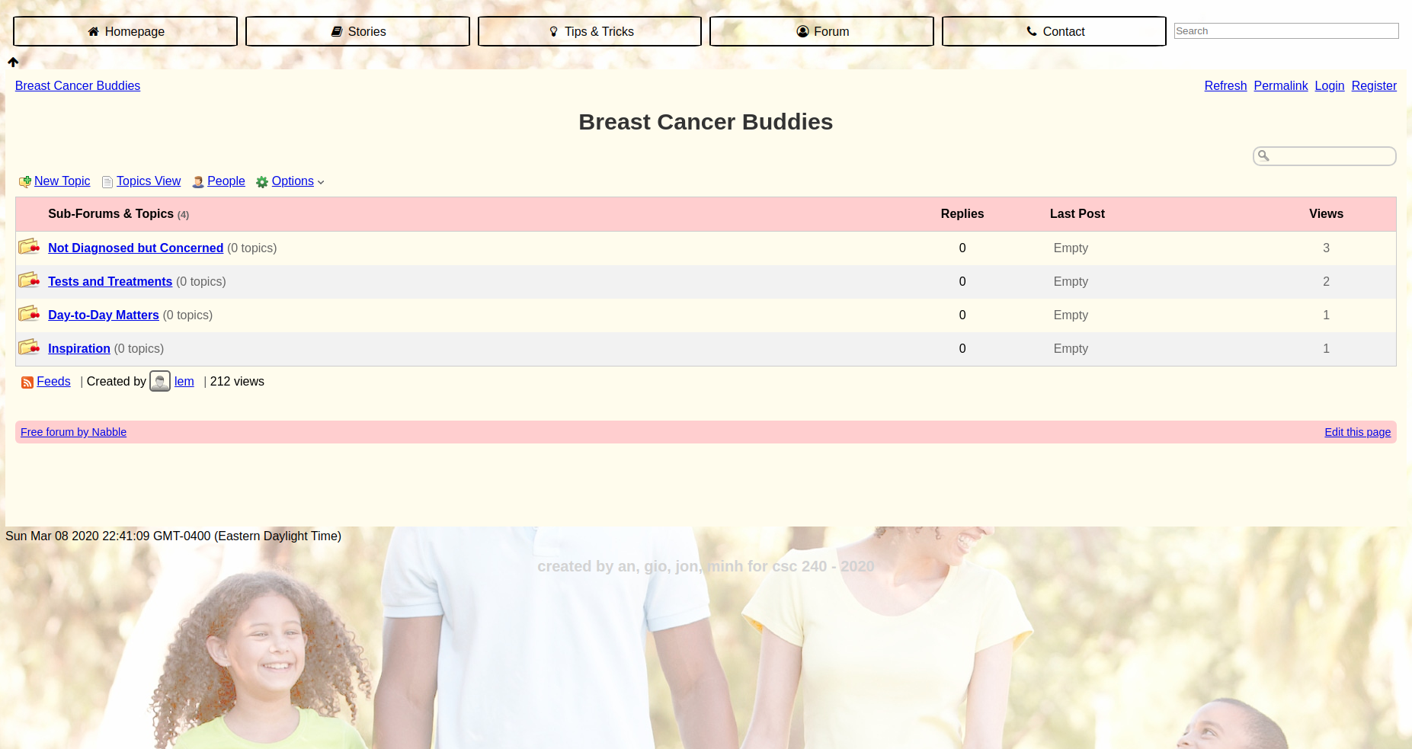
Forum

Slide 7
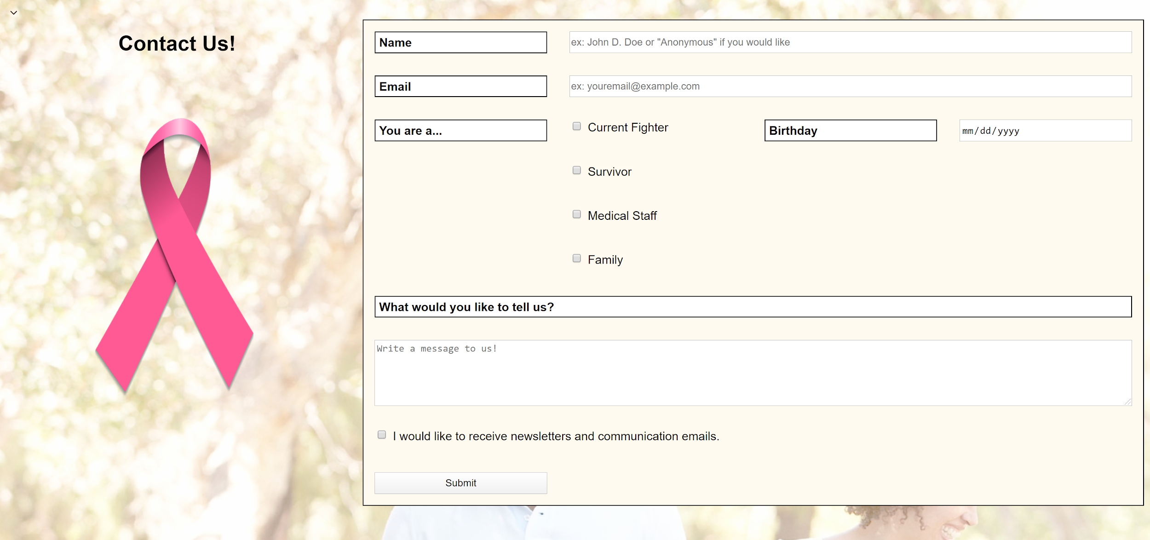
Contact

Slide 8
Technologies
HTML
General structure of the entire website.
CSS
General styling of the entire website.
JavaScript
Contact Us form: validating the fields on submission.
PHP
Contact Us form: changes when form submits.
jQuery
Slideshow on homepage.
Embedding navigation bar.

Slide 9
Incomplete Part(s) and Reasons
Search Bar
Unnecessary functionality
Too difficult to implement when having to implement everything else
Low priority task; would have been completed once everything else was completed
Database
Slightly unnecessary functionality
Could not figure out how to put information given by POST to MySQL database
Overall unsure of communication between languages

Slide 10
Evaluation
Overall easy to use.
Clear information that is easy to digest.
Visually very appealing across all pages.
Does not suffer from slowdown.

Slide 11
External Resources
Navigation bar: we used jQuery as well as an external stylesheet that contains all necessary icons we need for the navigation bar. (link: https://www.w3schools.com/jquery/jquery_get_started.asp)
Homepage: the carousel is built using Slick (link: https://kenwheeler.github.io/slick/)
Forum: we embedded the free forum site from Nabble to our website.
CSS: create columns (link: https://www.w3schools.com/howto/howto_css_two_columns.asp)

Slide 12
Contributions
An
Designed wireframe.
CSS in the general stylesheet as well as the individual pages, some HTML additions in Tips and Tricks and Stories.
Gio
Created the initial HTML for stories and Tips and Tricks pages
Designed the php code for the form with Jon.
Jonathan
Created the NavBar and Contact Us page.
Designed the php code with Gio.
Minh
Created Homepage and Forum (all HTML content and CSS).

